Slide 1
CS-32
DATA WAREHOUSING WITH SQL SERVER 2012

Slide 2
WHAT IS DATA WAREHOUSE?
The term "Data Warehouse" was first coined by Bill Inmon in 1990.
Definition:
According to Inmon, a data warehouse is a subject oriented, integrated, time-variant, and non-volatile collection of data.
This data helps analysts to take informed decisions in an organization.
Data warehousing is the process of constructing and using a data warehouse. A data warehouse is constructed by integrating data from multiple heterogeneous sources that support analytical reporting, structured and/or ad hoc queries, and decision making.

Slide 3
A data warehousing is a technique for collecting and managing data from varied sources to provide meaningful business insights. It is a blend of technologies and components which allows the strategic use of data.
It is electronic storage of a large amount of information by a business which is designed for query and analysis instead of transaction processing. It is a process of transforming data into information and making it available to users in a timely manner to make a difference.
Data warehousing is a collection of methods, techniques, and tools used to support knowledge workers—senior managers, directors, managers, and analysts—to conduct data analyses that help with performing decision-making processes and improving information resources

Slide 4
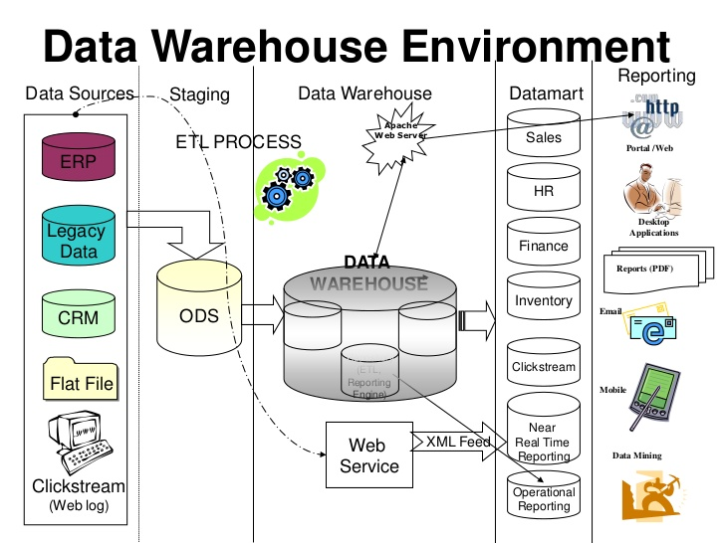

Slide 5
Understanding a Data Warehouse:
A data warehouse is a database, which is kept separate from the organization's operational database.
There is no frequent updating done in a data warehouse.
It possesses consolidated historical data, which helps the organization to analyze its business.
A data warehouse helps executives to organize, understand, and use their data to take strategic decisions.
Data warehouse systems help in the integration of diversity of application systems.
A data warehouse system helps in consolidated historical data analysis.
A data warehouse is a collection of data that supports decision-making processes.

Slide 6
FUTURE TRENDS IN DATA WAREHOUSING:
Data warehousing will remain. Methods will evolve. Newer technologies and cloud will dominate this field.
Data Warehousing is not going away anytime soon. But the way we do it either optimizing with Data Warehouse Automation and much more Engineering (Data Engineering) will be part of the jobs as it is in companies like Facebook, Airbnb, etc. already.
The modern data warehouse is changing the face of Big data and Business Intelligence by providing an easier yet effective and all-powerful ways to achieve the requirements of the new trends.
Users can stream data in real-time by bridging the stored data from past with the live data.

Slide 7
Data warehousing continues to move beyond simple storage, calling for new ways to ingest data, extract information and analyze data.
Companies, however, are faced with tight timelines, limited resources, the desire to respond to insights in real-time and ever-changing needs, so data warehouse providers need to automate more tasks and make data more accessible for both their SMBs(Small or Medium-Sized Business) and Enterprise clients.

Slide 8
DATA WAREHOUSE FEATURES(CHARACTERISTICS)
The key features of a data warehouse are discussed below −
Subject Oriented
Integrated
Time Variant
Non-volatile

Slide 9
Subject Oriented: A data warehouse is subject oriented because it provides information around a subject rather than the organization's ongoing operations. These subjects can be product, customers, suppliers, sales, revenue, etc. A data warehouse does not focus on the ongoing operations, rather it focuses on modeling and analysis of data for decision making.
Integrated: A data warehouse is constructed by integrating data from heterogeneous sources such as relational databases, flat files, etc. This integration enhances the effective analysis of data.

Slide 10
Time Variant − The data collected in a data warehouse is identified with a particular time period. The data in a data warehouse provides information from the historical point of view.
Non-volatile − Non-volatile means the previous data is not erased when new data is added to it. A data warehouse is kept separate from the operational database and therefore frequent changes in operational database is not reflected in the data warehouse.

Slide 11
DATA WAREHOUSE APPLICATIONS
Here, are most common sectors where Data warehouse is used:
Banking:
It is widely used in the banking sector to manage the resources available on desk effectively. Few banks also used for the market research, performance analysis of the product and operations.
Airline:
In the Airline system, it is used for operation purpose like crew assignment, analyses of route profitability, frequent flyer program promotions, etc.

Slide 12
Healthcare:
Healthcare sector also used Data warehouse to plan and predict outcomes, generate patient's treatment reports, share data with tie-in insurance companies, medical aid services, etc.
Public sector:
In the public sector, data warehouse is used for intelligence gathering. It helps government agencies to maintain and analyze tax records, health policy records, for every individual.
Investment and Insurance sector:
In this sector, the warehouses are primarily used to analyze data patterns, customer trends, and to track market movements.

Slide 13
Retain chain:
In retail chains, Data warehouse is widely used for distribution and marketing. It also helps to track items, customer buying pattern, promotions and also used for determining pricing policy.
Telecommunication:
A data warehouse is used in this sector for product promotions, sales decisions and to make distribution decisions.
Hospitality Industry:
This Industry utilizes warehouse services to design as well as estimate their advertising and promotion campaigns where they want to target clients based on their feedback and travel patterns.

Slide 14
Sr.No. | Data Warehouse (OLAP) | Operational Database(OLTP)
1 | It involves historical processing of information. | It involves day-to-day processing.
2 | OLAP systems are used by knowledge workers such as executives, managers, and analysts. | OLTP systems are used by clerks, DBAs, or database professionals.
3 | It is used to analyze the business. | It is used to run the business.
4 | It focuses on Information out. | It focuses on Data in.
5 | It is based on Star Schema, Snowflake Schema, and Fact Constellation Schema. | It is based on Entity Relationship Model.

Slide 15
6 | It focuses on Information out. | It is application oriented.
7 | It contains historical data. | It contains current data.
8 | It provides summarized and consolidated data. | It provides primitive and highly detailed data.
9 | It provides summarized and multidimensional view of data. | It provides detailed and flat relational view of data.
10 | The number of users is in hundreds. | The number of users is in thousands.
11 | The number of records accessed is in millions. | The number of records accessed is in tens.
12 | The database size is from 100GB to 100 TB. | The database size is from 100 MB to 100 GB.
13 | These are highly flexible. | It provides high performance.

Slide 16
DATA WAREHOUSE ARCHITECTURES
There are mainly three types of Data warehouse Architectures:
Single-tier architecture
Two-tier architecture
Three-tier architecture

Slide 17
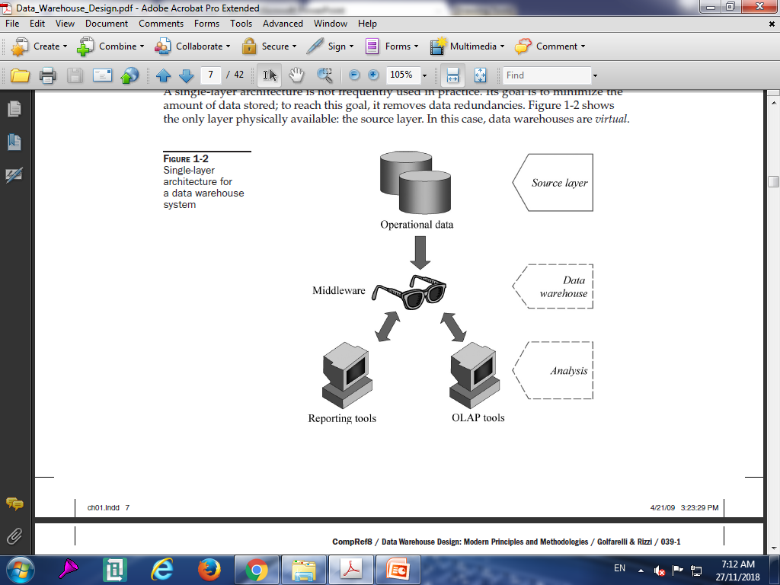
Single-tier architecture:
The objective of a single layer is to minimize the amount of data stored. This goal is to remove data redundancy. This architecture is not frequently used in practice.

Slide 18
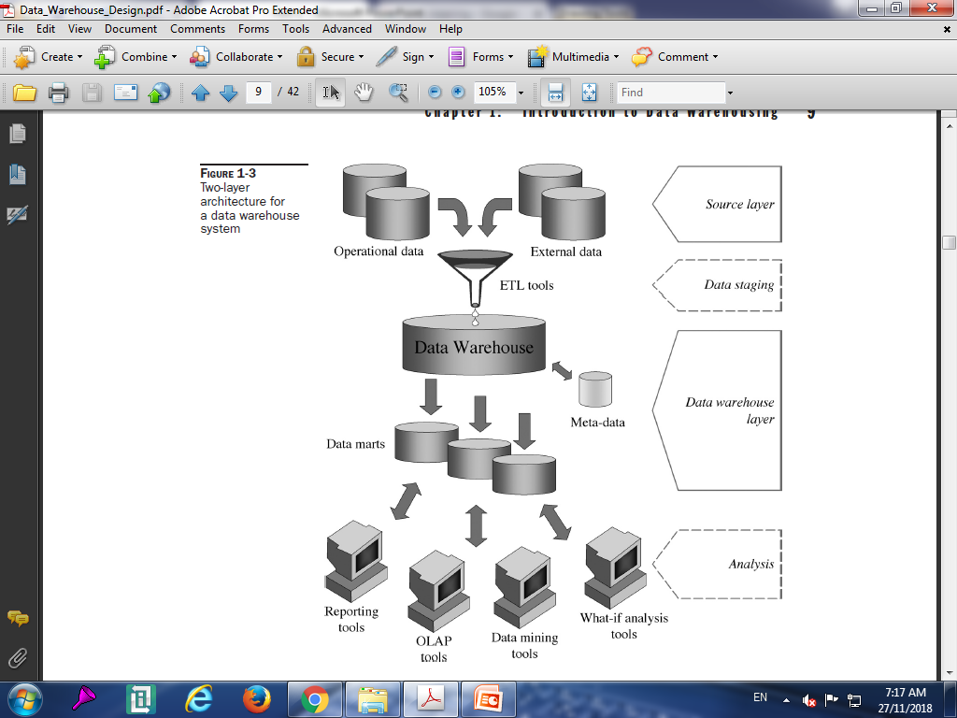
Two-tier architecture:
Two-layer architecture separates physically available sources and data warehouse. This architecture is not expandable and also not supporting a large number of end-users. It also has connectivity problems because of network limitations.

Slide 19
Source layer: A data warehouse system uses heterogeneous sources of data. That data is originally stored to corporate relational databases or legacy databases, or it may come from information systems outside the corporate walls.
Data staging: The data stored to sources should be extracted, cleansed to remove inconsistencies and fill gaps, and integrated to merge heterogeneous sources into one common schema. The so-called Extraction, Transformation, and Loading tools (ETL) can merge heterogeneous schemata, extract, transform, cleanse, validate, filter, and load source data into a data warehouse

Slide 20
Data warehouse layer: Information is stored to one logically centralized single repository: a data warehouse. The data warehouse can be directly accessed, but it can also be used as a source for creating data marts, which partially replicate data warehouse contents and are designed for specific enterprise departments. Meta-data repositories store information on sources, access procedures, data staging, users, data mart schemata, and so on.
What is Data Mart?
A data mart is focused on a single functional area of an organization and contains a subset of data stored in a Data Warehouse.
A data mart is a condensed version of Data Warehouse and is designed for use by a specific department, unit or set of users in an organization. E.g., Marketing, Sales, HR or finance. It is often controlled by a single department in an organization.

Slide 21
Analysis: In this layer, integrated data is efficiently and flexibly accessed to issue reports, dynamically analyze information, and simulate hypothetical business scenarios. Technologically speaking, it should feature aggregate data navigators, complex query optimizers, and user-friendly GUIs.

Slide 22
Three-tier architecture:
This is the most widely used architecture.
The requirement for separation plays a fundamental role in defining the typical architecture for a data warehouse system, as shown in below figure.
Although it is typically called a two-layer architecture to highlight a separation between physically available sources and data warehouses, it actually consists of four subsequent data flow stages
The following diagram depicts the three-tier architecture of data warehouse −

Slide 23
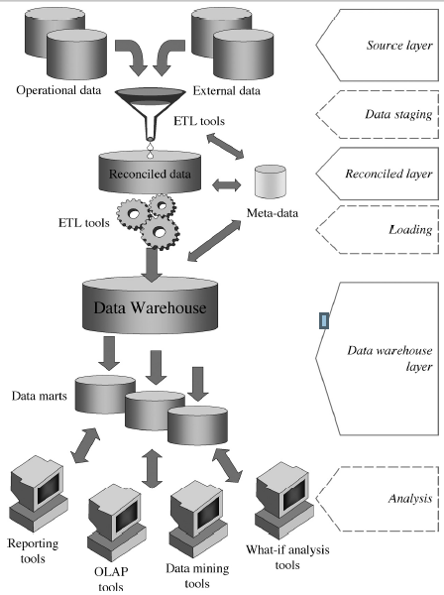

Slide 24
In this architecture, the third layer is the reconciled data layer or operational data store.
This layer materializes operational data obtained after integrating and cleansing source data. As a result, those data are integrated, consistent, correct, current, and detailed.
The above figure shows a data warehouse that is not populated from its sources directly, but from reconciled data.
The main advantage of the reconciled data layer is that it creates a common reference data model for a whole enterprise. At the same time, it sharply separates the problems of source data extraction and integration from those of data warehouse population.

Slide 25
Remarkably, in some cases, the reconciled layer is also directly used to better accomplish some operational tasks, such as producing daily reports that cannot be satisfactorily prepared using the corporate applications, or generating data flows to feed external processes periodically so as to benefit from cleaning and integration.
However, reconciled data leads to more redundancy of operational source data.

Slide 26
DATA FLOW ARCHITECTURE:
The data flow architecture is about how the data stores are arranged within a data warehouse and how the data flows from the source systems to the users through these data stores.

Slide 27
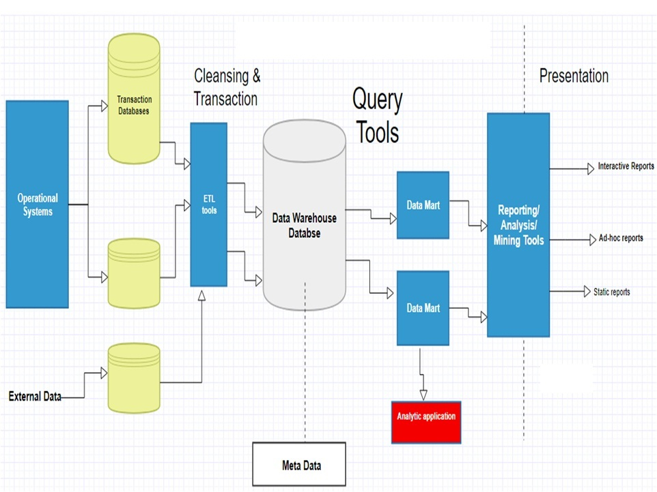

Slide 28
COMPONENTS OF DATA WAREHOUSE
Four components of Data Warehouses are:
Load manager
Warehouse Manager
Query Manager
End-user access tools
Load manager:
Load manager is also called the front component. It performs with all the operations associated with the extraction and load of data into the warehouse. These operations include transformations to prepare the data for entering into the Data warehouse.

Slide 29
Warehouse Manager:
Warehouse manager performs operations associated with the management of the data in the warehouse.
It performs operations like analysis of data to ensure consistency, creation of indexes and views, generation of denormalization and aggregations, transformation and merging of source data and archiving and baking-up data.
Query Manager:
Query manager is also known as backend component. It performs all the operation operations related to the management of user queries. The operations of this Data warehouse components are direct queries to the appropriate tables for scheduling the execution of queries.

Slide 30
End-user access tools:
This is categorized into five different groups like
1. Data Reporting
2. Query Tools
3. Application development tools
4. EIS( Executive information system) tools,
5. OLAP tools and data mining tools.

Slide 31
ADVANTAGES OF DATA WAREHOUSE
The three major advantages are:
1. Integrating data from multiple sources
2. Performing new types of analyses
3. Reducing cost to access historical data
Other benefits may include:
1. Standardizing data across the organization, a "single version of the truth"
2. Improving turnaround time for analysis and reporting
3. Sharing data and allowing others to easily access data
4. Supporting ad hoc reporting and inquiry
5. Reducing the development burden on IS/IT
6. Removing informational processing load from transaction-oriented databases

Slide 32
Types of Data warehouse:
Enterprise Data Warehouse(EDW).
Operational Data Store(ODS).
Data Mart.
Others:
Online
Offline
Real time
Integrated

Slide 33
Enterprise Data Warehouse(EDW):
An Enterprise database is a database that brings together varied functional areas of an organization and brings them together in a unified manner.
It is a centralized place where all business information from different sources and applications are made available. Once it is stored they can be used for analytics and can be used by all the people across the organization.
The data can be classified according to the subject and it gives access as per the necessary division.
An Enterprise Data warehouse will already have the steps of extracting, transforming and conforming already handled.

Slide 34
Operational Data Store(ODS):
As an alternative to having an operational decision support system application an operational data store is used.
It helps in accessing data directly from the database which also supports transaction processing.
The data which is present in the Operational Data Store can be scrubbed and the redundancy which is present can be checked and resolved by checking the corresponding business rules.
It also helps in integrating contrasting data from multiple sources so that business operations, analysis, and reporting can be easily carried out and help the business while the process is still in continuation.

Slide 35
Data Mart:
Data Mart focuses on storing data for a particular functional area and it contains a subset of data that is stored in a data warehouse.
Data Marts help in enhancing user responses and also reduces the volume of data for data analysis. It makes it easier to go ahead with the research.
Data Mart being a subset of Data warehouse is easy to implement. It is cost-effective when compared with a complete data warehouse. It is more open to change, and a single subject matter expert can define its structure and configuration.

Slide 36
What is 1st Party Data?
What is 2nd Party Data?
What is 3rd Party Data?

Slide 37
What is 1st Party Data?
First party data is the information you collect directly from your audience or customers. It includes:
--Data from behaviors, actions or interests -demonstrated across your website(s) or app(s).
--Data you have in your CRM
--Subscription data
--Social data
It can also include non-online information such as completed surveys, customer feedback and other customer information stored in your CRM database.

Slide 38
What Is 2nd Party Data?
Second party data is essentially someone else’s first party data. The seller collects data straight from their audience, and it all comes from one source. You can feel confident in its accuracy.
You purchase 2nd party data directly from the company that owns it. There’s no middle-man in such a transaction. It requires you to seek out companies with data you need and form a relationship with them.
Second party data is similar to first party data, but it comes from a source other than your own audience.

Slide 39
What Is 3rd Party Data?
Third party data is data that you buy from outside sources that are not the original collectors of that data. Instead, you buy it from large data aggregators that pull it from various other platforms and websites where it was generated. These aggregators pay publishers and other data owners for their 1st party data.
The aggregators then collect it into one large data set and sell it as 3rd party data. Many different companies sell this kind of data, and it is accessible through many different avenues.

Slide 40
After aggregating this data, providers organize them into categories based on aspects such as industry, audience behaviors and interests and demographic characteristics such as age and gender.
Each category is then broken down into specific segments, and the buyer chooses which particular segment they want to purchase from each individual buyer.
The name and contents of the 3rd party data segments will vary from provider to provider, so you need to understand what you are buying and where it came from before you make a purchase to power your campaigns.

